Slide 1
Northwestern Youth Fire Intervention Response, Education and Safety Partnership
A Community Response to Youth-set Fires

Slide 2
Sign-In

Slide 3
Homework Review

Slide 4
Class 2 Review
Notes:
Insert Course Outline from crappy slides

Slide 5
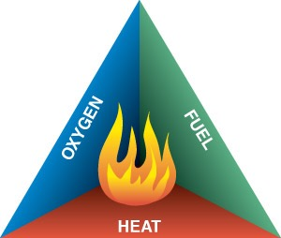
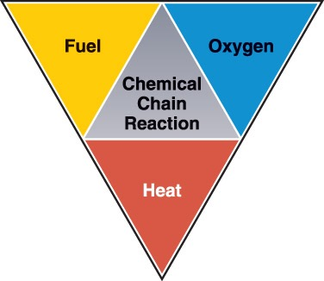
Conditions Needed for Fire
Three basic factors required for combustion:
Fuel
Oxygen
Heat
Chemical chain reactions keep the fire burning

Slide 6
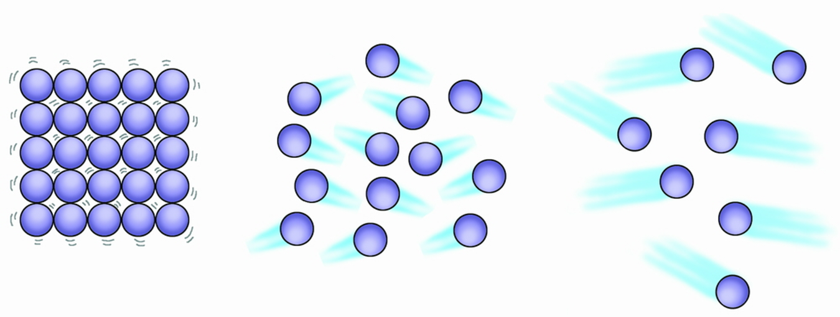
Liquid Solid Gas

Slide 7
Products of Combustion
Combustion produces smoke, heat, light and gases
Specific products depend on:
Fuel
Temperature
Amount of oxygen available

Slide 8
FIRE IS FAST
Fire doubles in size every 30 seconds

Slide 9
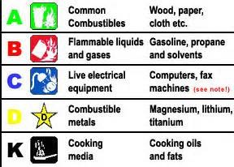
Types of Fires
ASH
BUBBLES
CIRCUITS
DENTS
KITCHEN

Slide 10
Heat Transfer
Combustion gives off heat which can ignite other nearby fuels.
Heat energy always flows from hotter to colder.
Three methods of heat transfer:
Conduction
Convection
Radiation

Slide 11
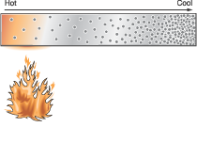
Conduction
Heat transferred from one molecule to another
Direct contact
Conductors transfer heat well
eg: Metal
Insulators do not transfer heat well
eg: Fiberglass

Slide 12
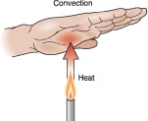
Convection
Movement of heat through a fluid medium such as air or a liquid.
Creates convection currents

Slide 13
Convection within a Room
Hot gases rise, then travel horizontally.
Gases then bank down a wall or move outside the room.
Horizontally
Vertically

Slide 14
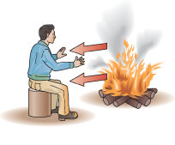
Radiation
Transfer of heat in the form of an invisible wave
Heat radiated to a nearby structure can ignite it
Radiated heat passing through a window can ignite an object

Slide 15
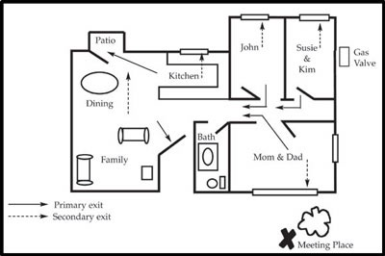
E.D.I.T.H.
EXIT
DRILLS
IN
THE
HOUSE

Slide 16
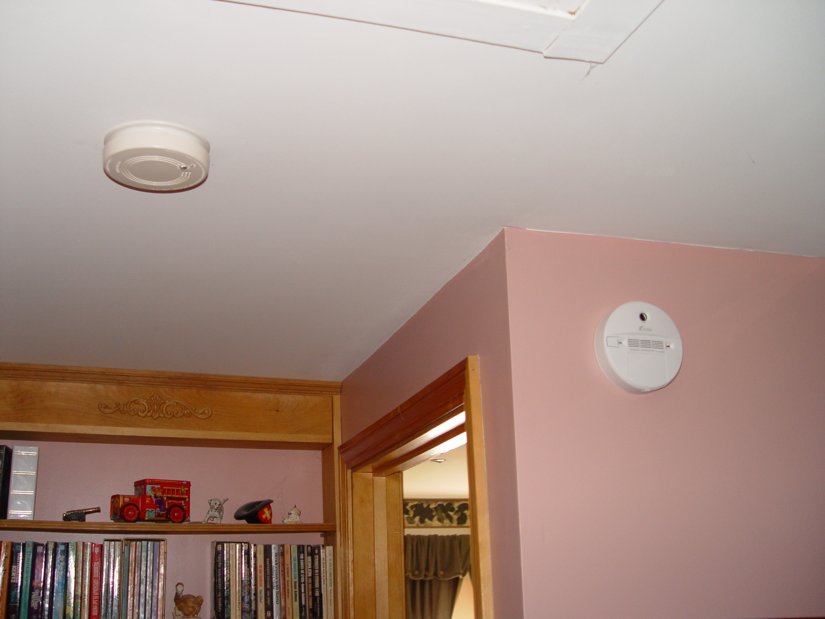
Carbon monoxide
detector
Smoke detector

Slide 17
Smoke
Airborne products of combustion
Consists of:
Particles
Vapors
Gases
Inhalation of smoke can cause severe injuries.

Slide 18
Class 3: Burn Injuries

Slide 19
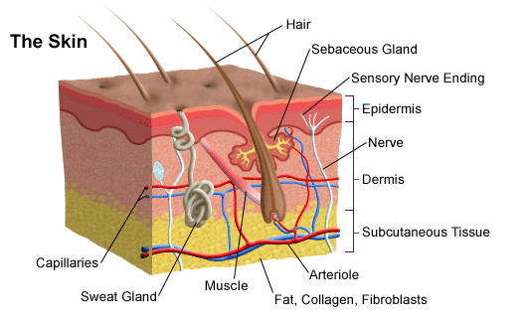
Layers of Skin

Slide 20
Types of Burn Injuries
Thermal
Chemical
Electrical
Radiation

Slide 21
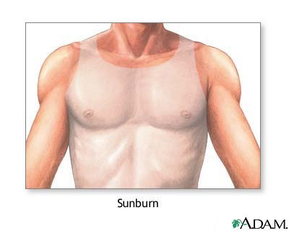
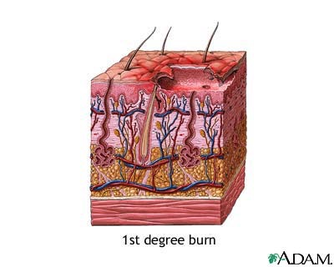
1st Degree
Painful/reddened skin
Minor to moderare pain
Heals in about 1 week
Can be treated with cool, clean cloth

Slide 22
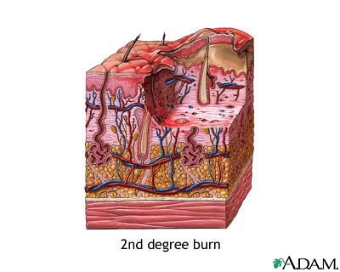
2nd Degree
Blisters may be present
Moderate to severe pain
Usually 2-3 weeks to heal

Slide 23
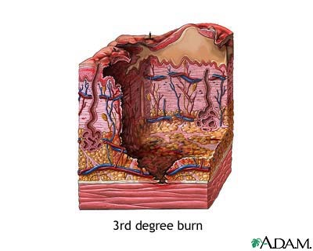
3rd Degree
Underlying muscles and tissues destroyed
Pain absent because nerve endings destroyed
Skin appears charred or white

Slide 24
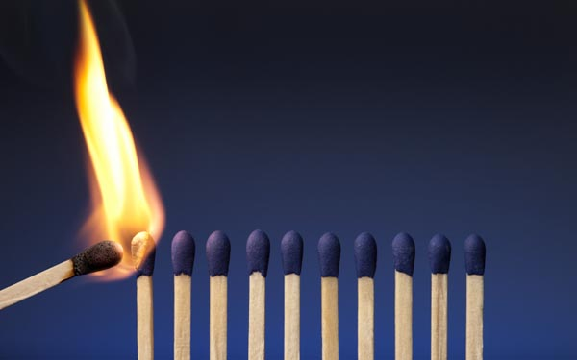
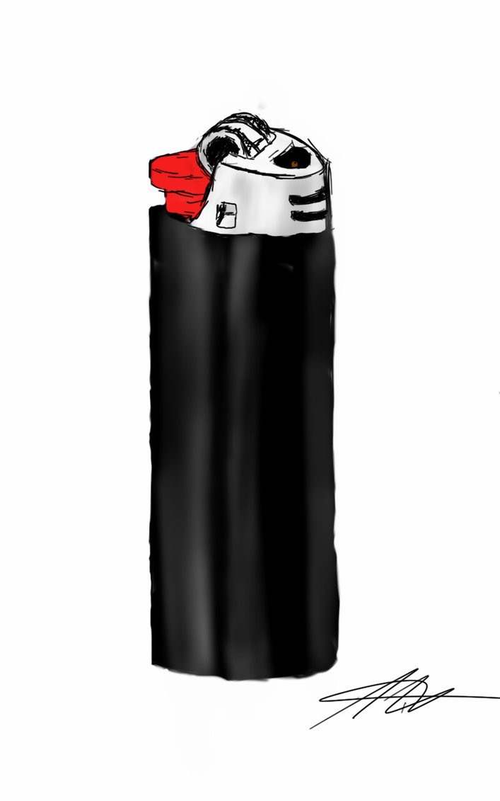
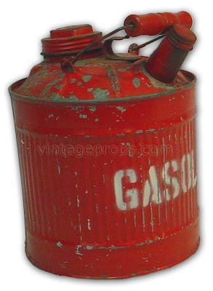
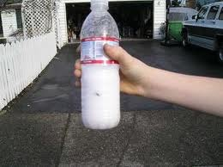
Learn not to burn

Slide 25
In A Flash

Slide 26
SUMMARY
Burns are very serious injuries
Alert adults about ignition materials
Store fuel safely

Slide 27
HOMEWORK
Apology Letter Worksheet

