Slide 1
Northwestern Youth Fire Intervention Response, Education and Safety Partnership
A Community Response to Youth-set Fires

Slide 2
Mission Statement
A collaboration of fire, law enforcement, mental healthcare providers and social service agencies, NoFIRES is committed to providing a consistent, coordinated and appropriate response to youth under the age of 18 years old, who set fires or engage in fire-related behavior.
The components of this approach include: intervention, education and prevention, and referrals for clinical treatment and counseling and/or to service agencies.

Slide 3
Introductions

Slide 4
Sign-In

Slide 5
Expectations
Attend all classes and be on time
No media devices
Be engaged
Participate in class discussions
Have a positive attitude
Complete homework assignments

Slide 6
Class 1- What Is Fire & Home Escape Plan
Class 2 - Home Hazards & Home Safety
Class 3 - Consequences & Taking Responsibility
Course Outline

Slide 7
Why are we here?
Accountability
Education
Consequence
Prevent future fire setting incidents
Keep you, your family, and the community safe

Slide 8
Pre-Test

Slide 9
What is Fire?
A rapid chemical process that produces heat, gas, and usually light

Slide 10
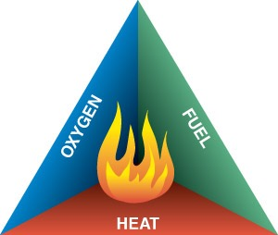
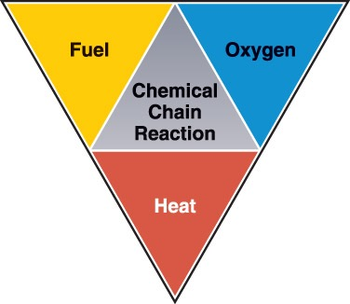
Fire Conditions
Three basic factors required for combustion:
-Fuel
-Oxygen
-Heat
Chemical chain reactions keep the fire burning

Slide 11
What Burns?
Matter
-Made up of atoms and molecules
-Can exist in 3 states

Slide 12
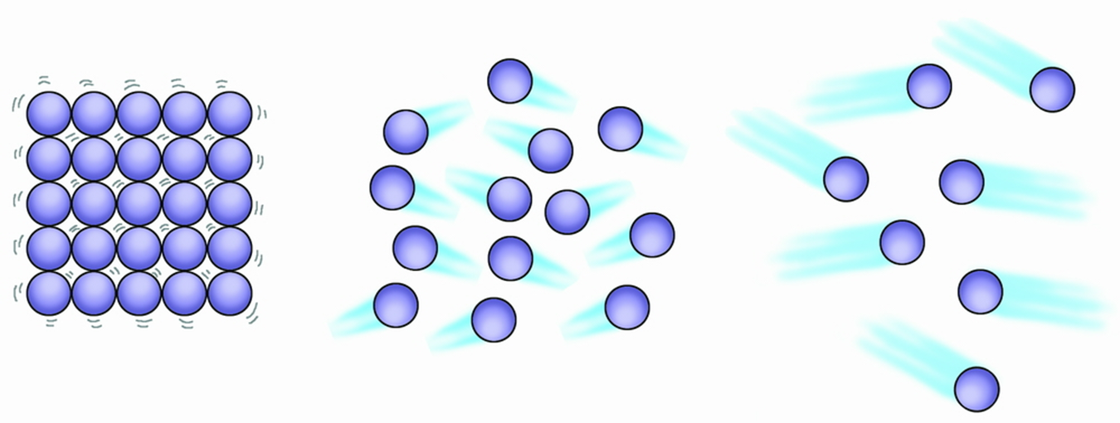
Liquid Solid Gas

Slide 13
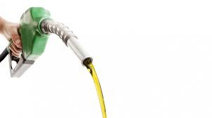
Liquids
Assume the shape of their containers
Vaporization is the release of a liquid’s molecules into the atmosphere

Slide 14
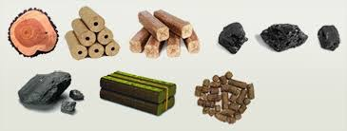
Solids
Most fuels are solids
Pyrolysis releases molecules into atmosphere
Converts solid to a gas

Slide 15
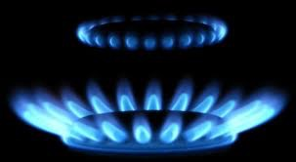
Gases
Have no shape and no volume
Expand indefinitely
Fuel-to-air ratio must be within a certain range to combust

Slide 16
Products of Combustion
Combustion produces smoke, heat, light, gases
Specific products depend on:
-Fuel
-Temperature
-Amount of oxygen available

Slide 17
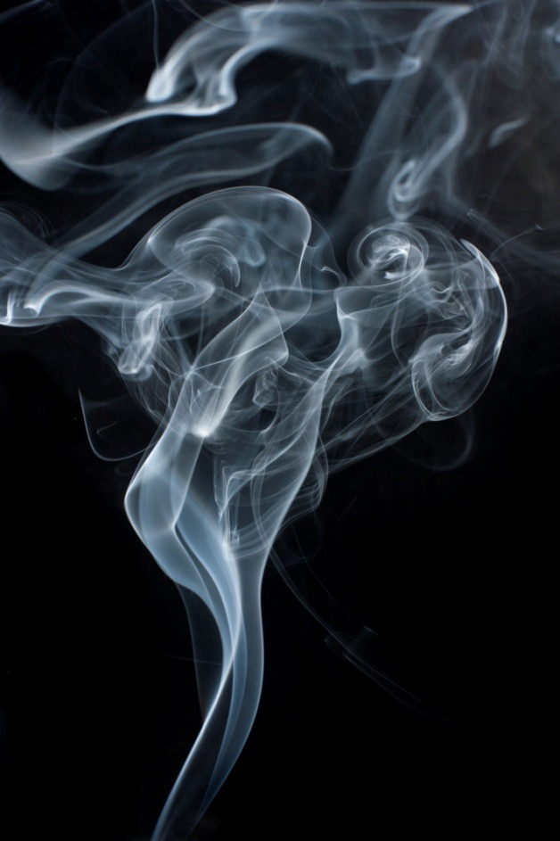
Smoke
Airborne products of combustion
-Particles
-Vapors
-Gases
Inhalation of smoke can cause severe injuries

Slide 18
Smoke Contents
Particles
-Solid matter consisting of unburned, partially burned or completely burned substances
-Can be hot and/or toxic
Vapors
-Small droplets of liquids suspended in air
-Can be oils from the fuel or water from suppression efforts

Slide 19
Smoke Contents
Common Gases:
Carbon Monoxide
Hydrogen Cyanide
Phosgene
Most gases produced by fire are toxic

Slide 20
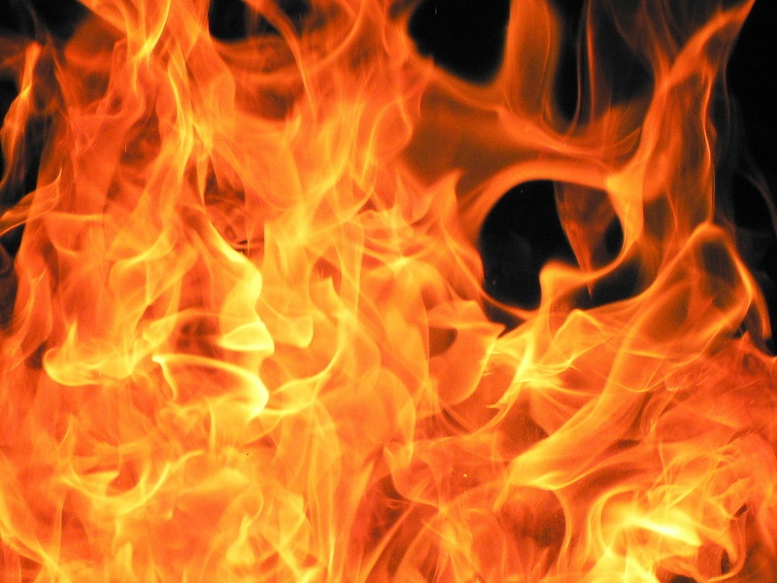
Fire is Fast
Fire doubles in size every 30 seconds

Slide 22
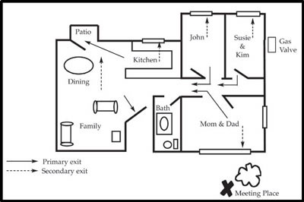
E.D.I.T.H.
EXIT
DRILLS
IN
THE
HOUSE

Slide 23
Summary
Matter is everywhere
3 states of matter: Liquid, Solid, Gas
Fire tetrahedron
Fire is fast
Products of combustion

Slide 24
Homework
Identify a meeting place for your family
Design an escape plan for your home
Demonstrate at least 2 ways out of every room

